Slide 1
Analysis of Market Capitalization in India's Top 500 Companies
Insights into Market Dynamics and Competitive Positioning through Financial Analytics

Slide 2
Introduction
This project focuses on analyzing the market capitalization of India's top 500 companies. By leveraging financial analytics, we aim to uncover key insights into market trends, competitive positioning, and the factors influencing the performance of these leading firms.
The analysis will help management make informed decisions to enhance strategic growth and market competitiveness.
By examining these key financial metrics, we aim to understand the competitive landscape and identify trends that influence market leadership. This analysis provides valuable insights into the financial health and strategic positioning of the leading companies in India's dynamic market.

Slide 3
Details of Data
The data is sourced from reputable financial databases, ensuring accuracy and relevance. Key attributes analyzed include market cap in crores, quarterly sales, and company names.
Dataset includes market capitalization and quarterly sales data for the top 500 companies in India. Key attributes analyzed are market cap in crores and quarterly sales figures.
Market Capitalization
Quarterly Sales
Top 500 Companies
Financial Metrics

Slide 4
Main KPIs
Market Capitalization: Total market value of each company's outstanding shares.
Quarterly Sales: Revenue generated by each company within a specific quarter.
Growth Rate: Percentage change in market cap and sales over time.
Market Share: Proportion of total market value held by each company.

Slide 5
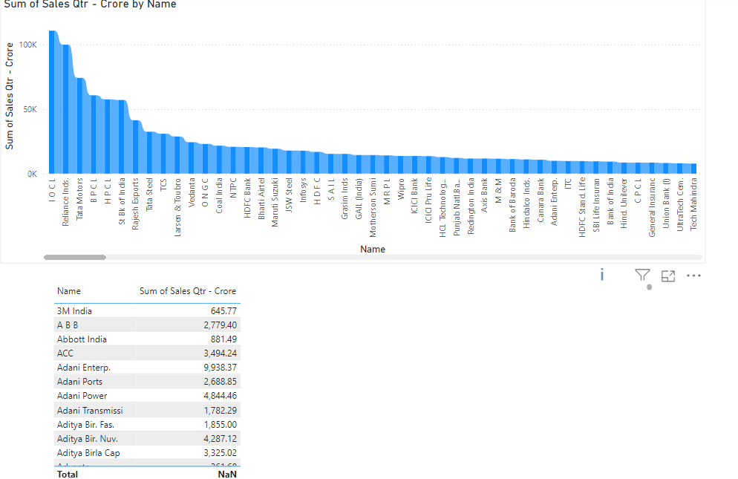
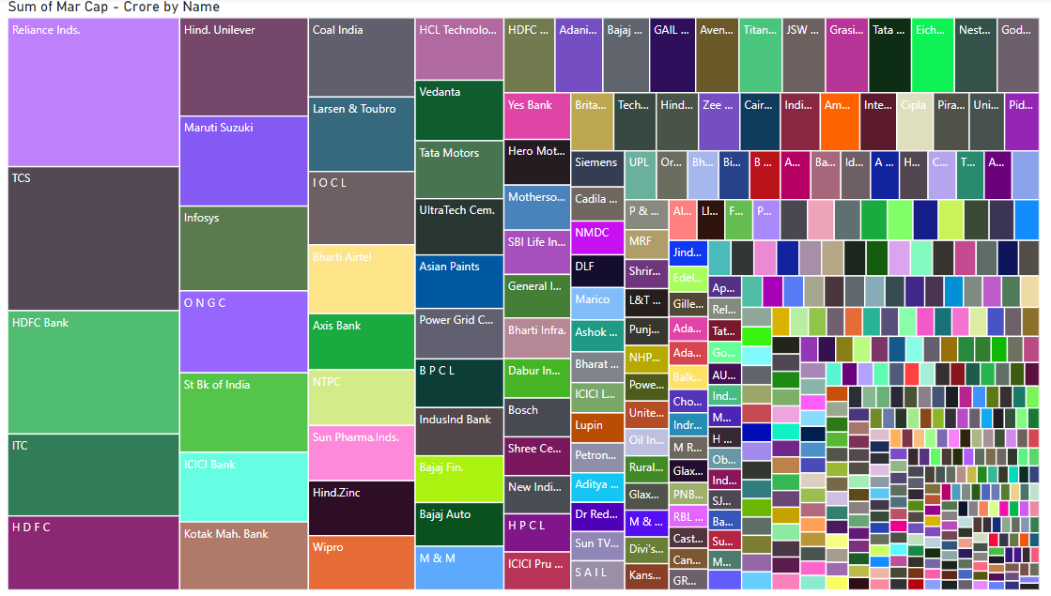
Dashboard

Slide 6
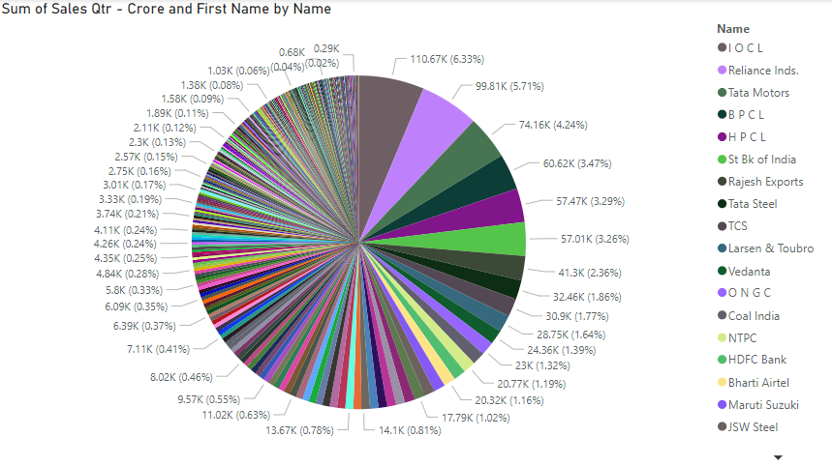
My Design

Slide 7
……………………………………………………………..
Thank you

